Slide 1


Hospital Resource Utilization Analysis Using AI & Machine Learning Domain: Healthcare Analytics
Project Title
Leader in Consulting
https://gncipl.com/
Prepared By: Simran Bhadouria

Slide 2
Introduction
Project Overview
Tools Used:
Python
Pandas
NumPy
Matplotlib
Seaborn
Scikit-Learn
Used for Machine Learning
Power BI
Healthcare organizations must efficiently manage resources such as hospital beds, medical staff, and treatment facilities.
This project analyzes hospital resource utilization to identify:
Bed occupancy patterns
Staff allocation efficiency
Patient admission trends
Resource bottlenecks
Abnormal utilization patterns
Machine Learning techniques are applied to improve hospital planning and operational efficiency.

Slide 3
Business Problem
Problem Statement
Hospitals often face challenges such as:
Overcrowded wards
Staff shortages
High patient admission rates
Uneven resource allocation
Reduced patient satisfaction
The objective is to analyze hospital operations and provide data-driven recommendations for resource optimization.

Slide 4
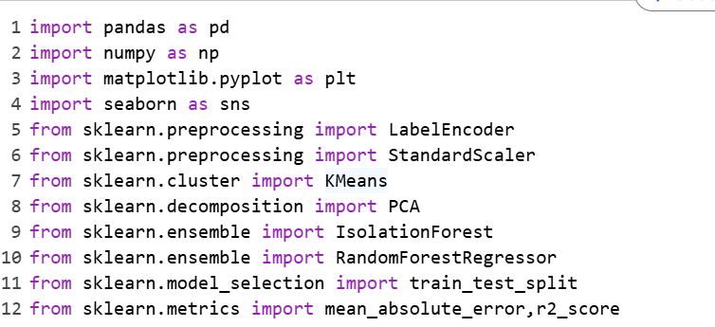

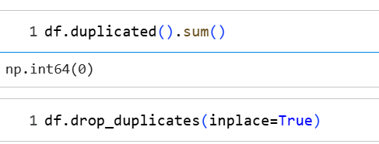
Dataset Information
Dataset Details
Source: Kaggle / Hospital Resource Utilization Dataset
Total Records: 208
Features
Week
Service Department
Patients Admitted
Average Length of Stay
Patient Satisfaction Score
Maximum Occupancy
Staff Count
Recommended Staff
Departments
ICU
Emergency
Surgery
General Medicine

Slide 5
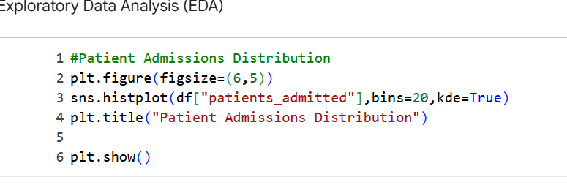
Project Workflow
Dataset
Cleaning
EDA
Feature Engineering
PCA
Clustering
ML Model
Insights
Project Methodology
Data Collection
Data Cleaning
Exploratory Data Analysis
Feature Engineering
Outlier Detection
Anomaly Detection
PCA Analysis
K-Means Clustering
Machine Learning Modeling
Business Insights & Recommendations

Slide 6

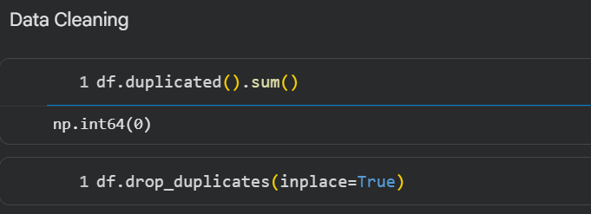
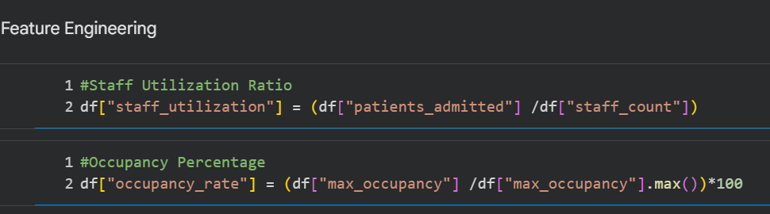
Data Cleaning & Feature Engineering
Data Preprocessing
Data Cleaning
Removed duplicate records
Handled missing values
Validated data consistency
Feature Engineering
Created:
Staff Utilization Ratio
Occupancy Rate
Resource Efficiency Metrics
These new features helped improve analysis and machine learning performance.

Slide 7
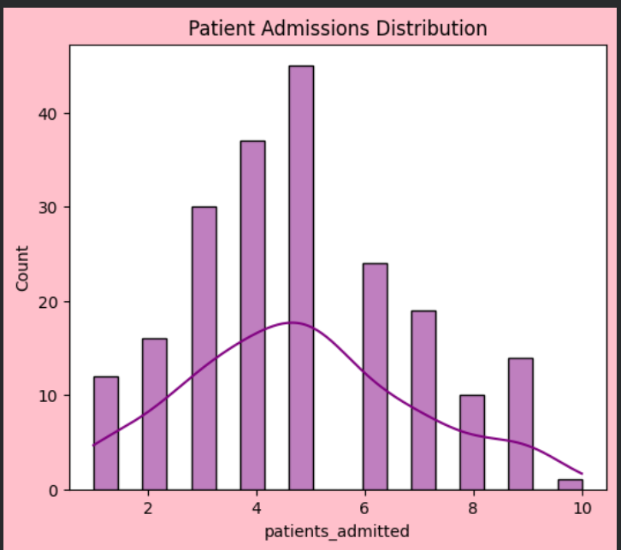
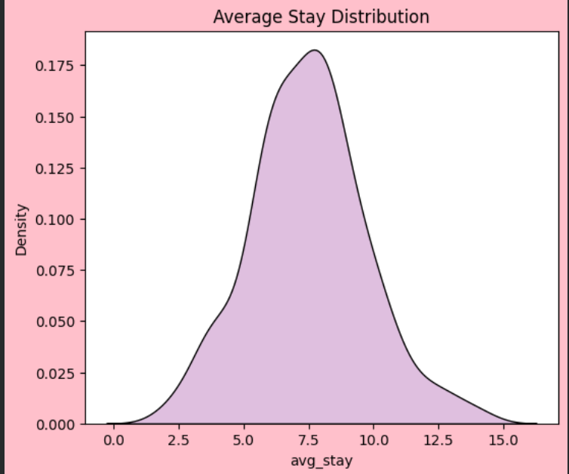
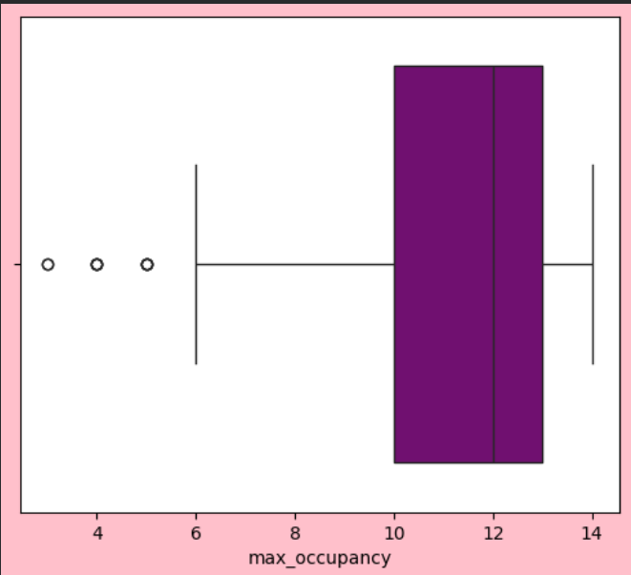
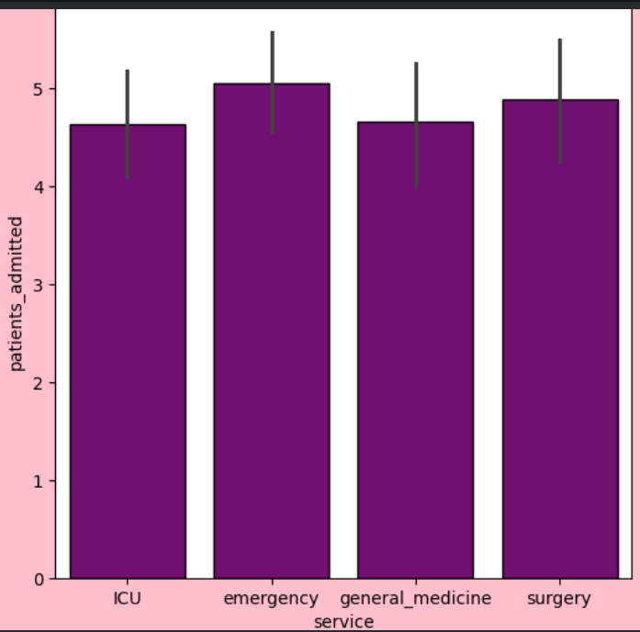
Exploratory Data Analysis (EDA)
Distribution Analysis
Histogram
KDE Plot
Comparative Analysis
Department-wise Admissions
Occupancy Analysis
Correlation Analysis
Correlation Matrix
Heatmap Visualization
Time-Series Analysis
Weekly Admission Trends
Resource Demand Patterns

Slide 8
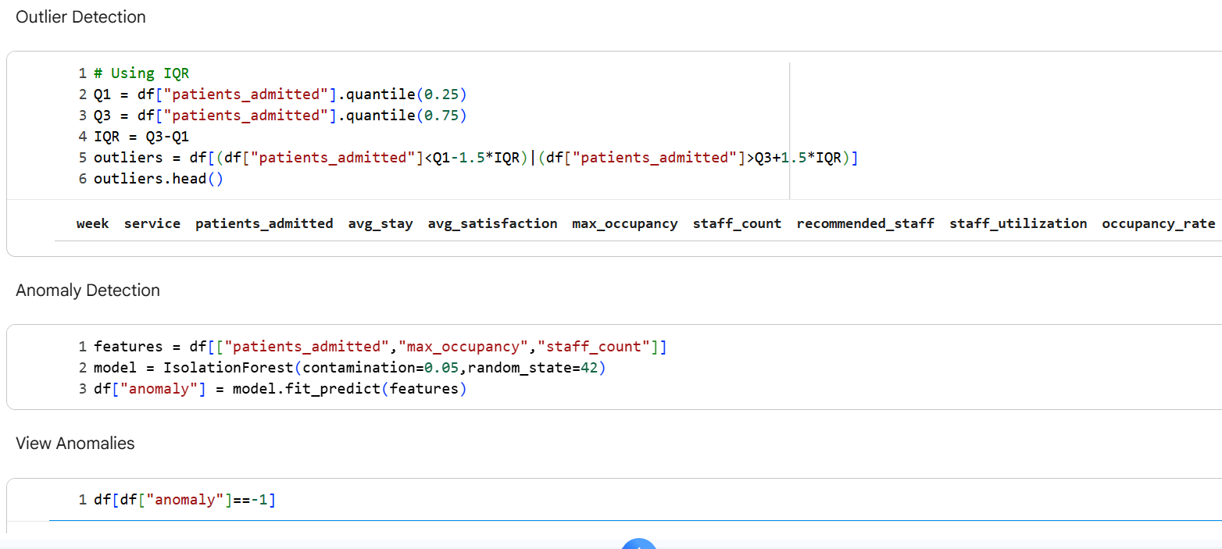
Outlier & Anomaly Detection
Outlier Detection
Used IQR Method to identify:
Extremely high admissions
Abnormal occupancy levels
Anomaly Detection
Used Isolation Forest Algorithm
Detected:
Staff shortage periods
Resource overload situations
Unusual hospital activity
Benefit
Helps hospitals identify operational risks early.

Slide 9
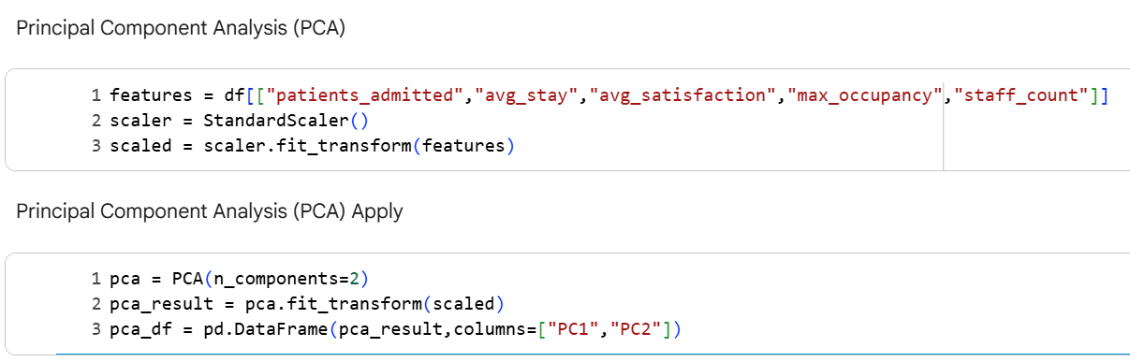
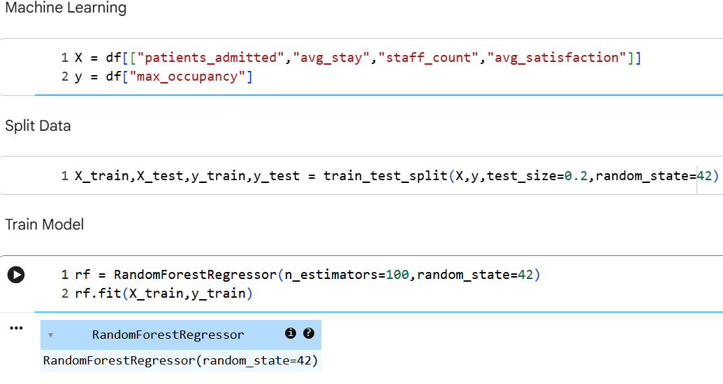
PCA, Clustering & Machine Learning Model
Patient Resource Segmentation
Principal Component Analysis (PCA)
Reduced multiple variables into two principal components
Bed Occupancy Prediction
Algorithm Used Random Forest Regressor
Input Features
Patients Admitted
Average Stay
Staff Count
Satisfaction Score
Target Variable
Maximum Occupancy
Model Evaluation
Metrics Used:
MAE (Mean Absolute Error)
R² Score
The model successfully predicted occupancy levels using operational hospital data.
Benefits:
Reduced complexity
Improved visualization
Better pattern recognition
K-Means Clustering
Grouped hospital utilization into:
Low Utilization
Medium Utilization
High Utilization

Slide 10
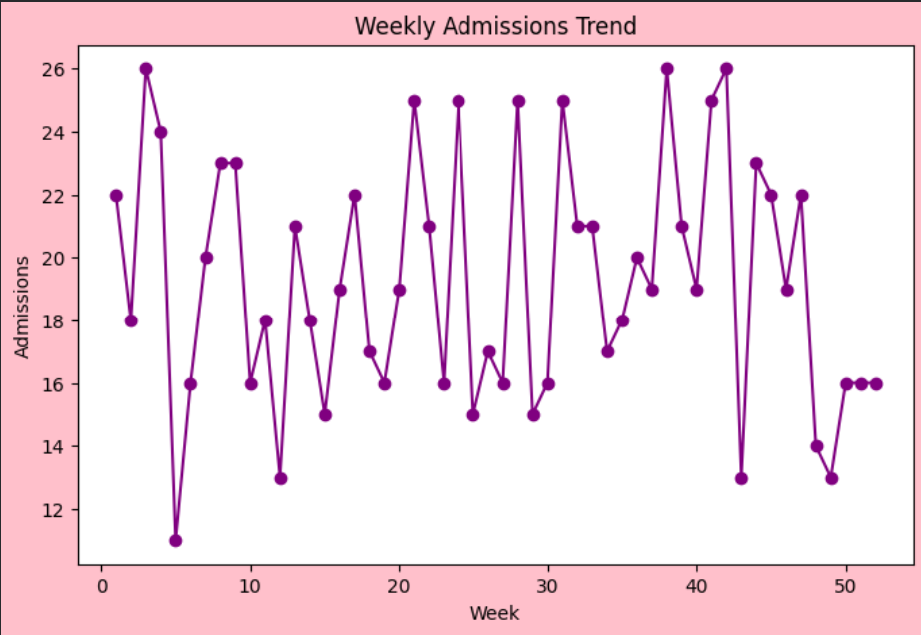
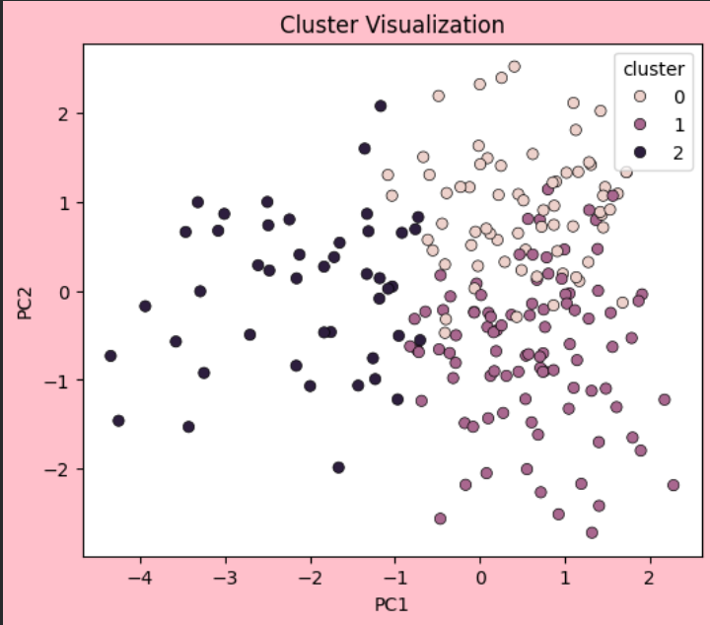
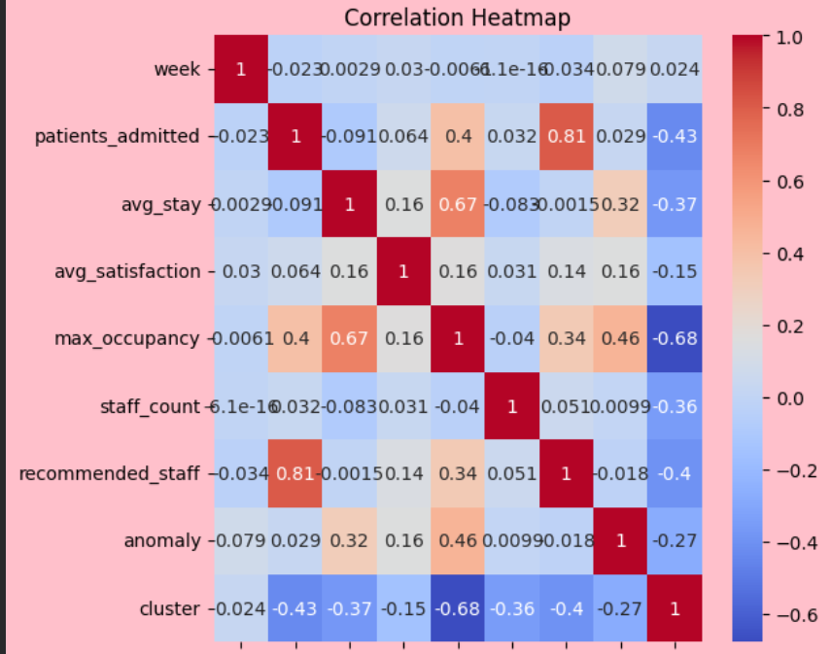
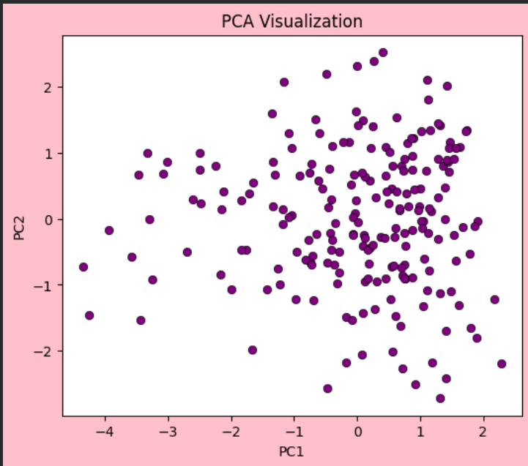
Dashborad

Slide 11
Key Insights
Major Findings
Resource Utilization
ICU and Emergency departments showed highest occupancy levels.
Staff Planning
Staff shortages were observed during high admission periods.
Admissions
Patient admissions strongly impacted occupancy rates.
Clustering
Three distinct utilization groups were identified.
Anomaly Detection
Several abnormal workload periods were detected.

Slide 12
Conclusion
This project successfully analyzed hospital resource utilization using Exploratory Data Analysis (EDA), Machine Learning, and statistical techniques.
The analysis revealed significant relationships between patient admissions, bed occupancy, staff availability, and patient satisfaction. Time-series analysis helped identify weekly trends in resource demand, while correlation analysis highlighted the factors influencing hospital occupancy levels.
Outlier detection and Isolation Forest-based anomaly detection identified unusual workload periods and potential staffing challenges. PCA reduced the complexity of the dataset and enabled better visualization of resource utilization patterns. K-Means Clustering segmented hospital operations into Low, Medium, and High Utilization groups, helping identify departments requiring additional attention.
A Random Forest Regression model was developed to predict bed occupancy levels, demonstrating how machine learning can support hospital planning and resource optimization.
Overall, the project provides valuable insights that can help healthcare organizations improve resource allocation, reduce overcrowding, enhance operational efficiency, and improve patient outcomes.

